Slide 1


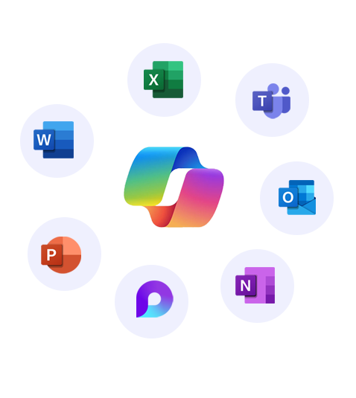


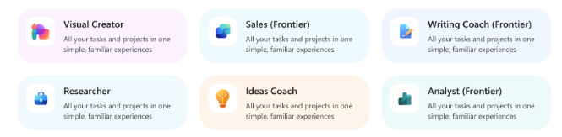
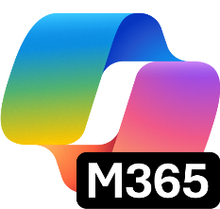


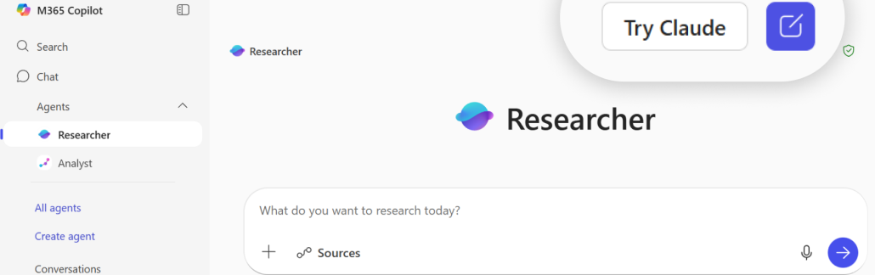
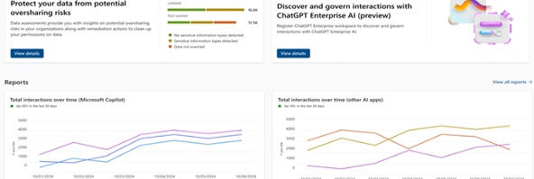
Transform your business with one AI solution – Copilot Business
Move beyond the basics. Unlock even more power of AI at work with Copilot Business. Work with Work IQ to surface insights, power market research, and strengthen strategic planning—reasoning across your meetings, emails, and documents.
All-in-1 AI productivity app
Integrated into existing apps
Secure AI chat
AI search enhanced by Work IQ
Ecosystem of pre-built agents
AI-generated multi-media
Centralize content of various types
Analytics, governance, and compliance
Embedded in Microsoft 365 apps you already use every day, with advanced AI skills like Agent Mode and Teams Mode
Powered by Work IQ
Agent platform
Memory​
Inference
You at work
Data
Ecosystem of pre-built Microsoft agents like Researcher, Analyst, and Facilitator, along with trusted agents from partners and custom agents
Intelligence that makes Microsoft 365 Copilot uniquely built for work
Model choice
Copilot Control system
Flexibility to choose between OpenAI and Anthropic models starting in Researcher, Agent Mode in Excel and when building agents in Copilot Studio
Robust security, management, measurement and reporting to understand impact and ensure standardized governance

Slide 2





Move from Quick Wins to Transformation
Empower every user across every role with a Copilot + Agent
Free AI Solution
Copilot Business
 | Summarize issues & suggest resolutions Draft empathetic replies Create FAQ & help docs | Summarizes long e-mail threads into next steps Update service documentation from historical inquiries Draft responses in context to e-mail thread with customer
 | Draft outreach emails & proposals Help brainstorm best ways to deal with customer objections Gain insight into potential customers based on publicly available data | Draft a personalized follow-up email referencing client’s last meeting Turn meeting notes into a formal proposal with pricing tables Build a branded pitch deck from a single-page summary
 | Generate campaign ideas Create social media calendar Generate content and provide SEO optimized keywords | Drafts compelling copy aligned to brand voice Create campaign briefs using pre-created template Researcher – Run competitive research, extract customer insights, and develop go-to-market strategies
 | Draft job descriptions or interview questions Create onboarding materials Provide neutral phrasing for sensitive communication | Summarizes candidate resumes or interview notes from stored files Auto-updates and reformats policy documents in Word Researcher - Analyzes hiring funnel trends, turnover data, compensation benchmarks vs market, DEI metrics
 | Create charts and visuals Gather competitor information and compare product capabilities Understand contract terms and suggest updates | Translates raw numbers into executive-friendly narratives Builds forecasts and financial models quickly Creates clear reports and presentations from complex data
Customer Service
Sales
Marketing
HR
Finance

Slide 3
Upgrade investment snapshot
Upgrade solution​ | {target_sku}
# Proposed seats for upgrade​ | {add_proposed_seat}
Actual cost of the solution per user | {actual_price_per_user}
Savings from promo price | {promo_savings_per_user}
Cost per user after adjusting promo price | {per_user_after_promo_price}
Incremental cost per user​ | {incremental_cost_per_user}​
Total incremental annual investment for {seats} seats | {overall_incremental_cost}
Take advantage of the limited time offer on Copilot Business + Business Standard bundle
Actual cost per user
Cost after promo
~35%
$33.5
$22
Savings from the promo
[NOTE - PLEASE DELETE BEFORE SENDING TO THE CUSTOMER]
The calculation above is based on active promos, partner MAICPP status, Microsoft Commercial Incentives, and Microsoft list price, and assumes additional information on margins. This is for reference only and subject to change. Please review the calculation, and adjust before sending it to the customer. Microsoft would not be responsible for the content or accuracy of any information/claim made in this document, or for any decisions made based on such information.

Slide 4
Accelerate your Secure AI transformation with [PARTNER NAME]
[INSTRUCTION FOR THE PARTNER] Partner to insert their personalized information on: Value proposition and methodology, experience, Microsoft services, advanced specializations, and past awards.
You can leverage Copilot Chat to customize this section! Add your website URL, upload this flyer on Copilot Chat, and prompt it to write a draft for this section.

